Slide 1
AI – Machine Learning
Presented By :
Adnan Zaidi
PAD - Pakistan Association Dubai

Slide 2
1. Background - Big-Data 2. Introduction to AI/Machine Learning 3. Machine Learning Techniques (Supervised / Unsupervised) (Semi Supervised / Reinforcement) 4. Applications/Examples

Slide 3
Introduction to BIG DATA

Slide 5

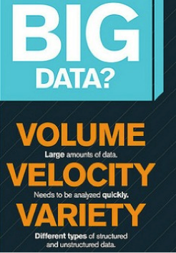
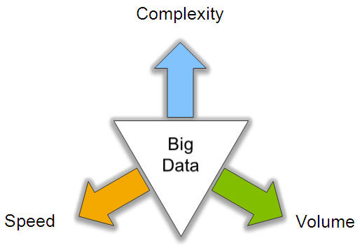
Big Data: 3V’s

Slide 6
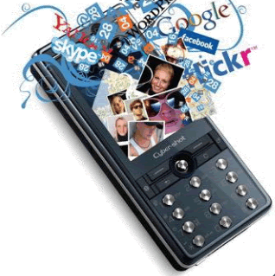
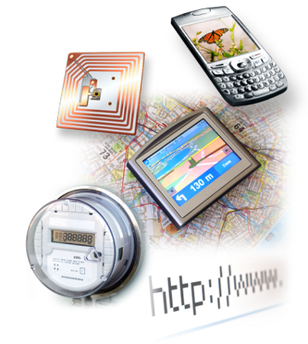

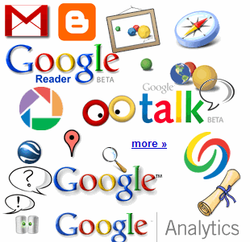

Big Data: Sources
4.6 billion camera phones world wide
30 billion RFID tags today (1.3B in 2005)
100s of millions of GPS enabled devices sold annually
? TBs of data every day
25+ TBs of log data every day
2+ billion people on the Web by end 2011
76 million smart meters in 2009… 200M by 2014

Slide 7
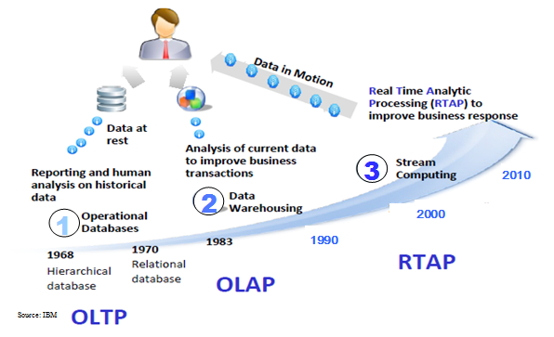
Harnessing Big Data
OLTP: Online Transaction Processing (DBMSs)
OLAP: Online Analytical Processing (Data Warehousing)
RTAP: Real-Time Analytics Processing (Big Data Architecture & technology)

Slide 8
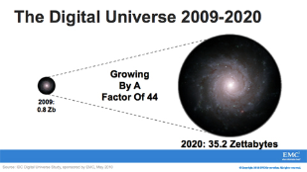
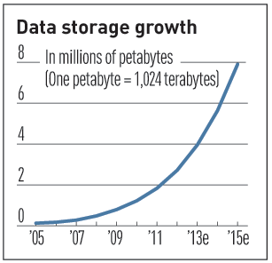

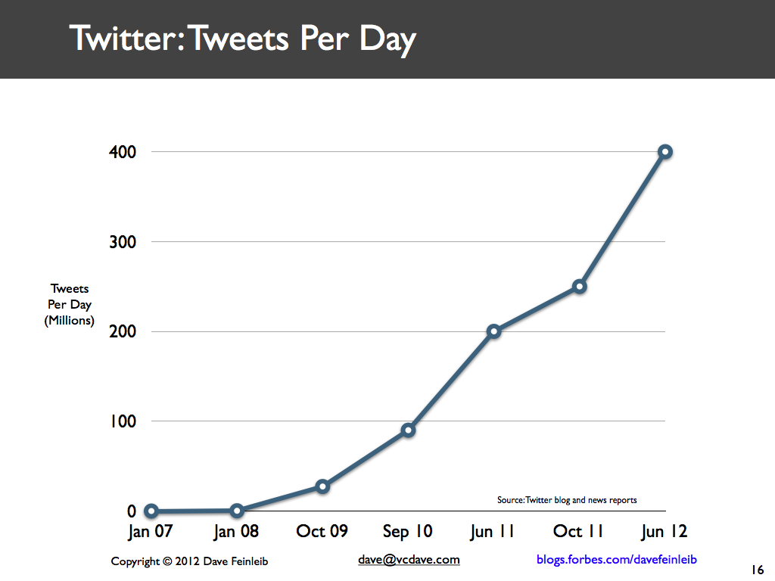
Volume (Scale)
Data Volume
44x increase from 2009 2020
From 0.8 zettabytes to 35zb
Data volume is increasing exponentially
Exponential increase in collected/generated data

Slide 9
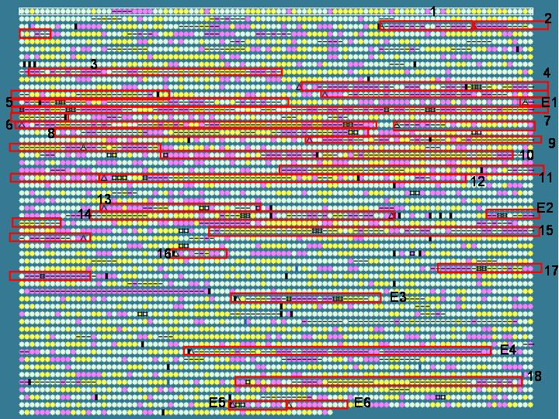
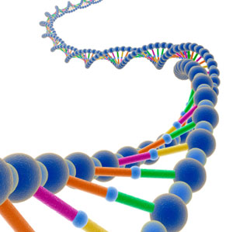
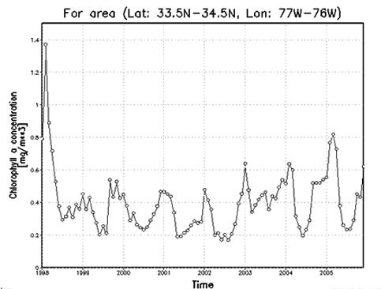
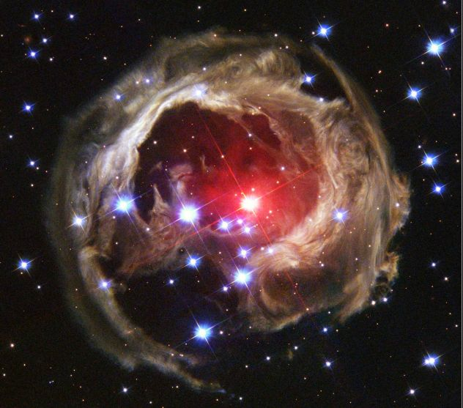
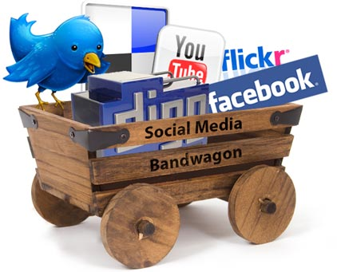
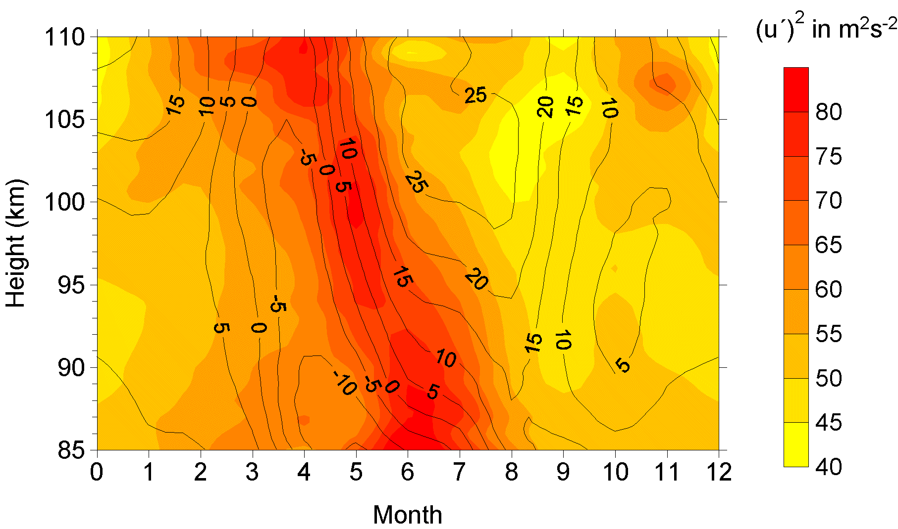
Variety (Complexity)
Relational Data (Tables/Transaction/Legacy Data)
Text Data (Web)
Semi-structured Data (XML)
Graph Data
Social Network, Semantic Web (RDF), …
Streaming Data
You can only scan the data once
A single application can be generating/collecting many types of data
Big Public Data (online, weather, finance, etc)
To extract knowledge➔ all these types of data need to linked together

Slide 10

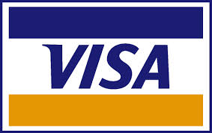















A Single View to the Customer
Social Media
Banking
Finance
Gaming
Our
Known
History
Customer
Entertain
Purchase

Slide 11
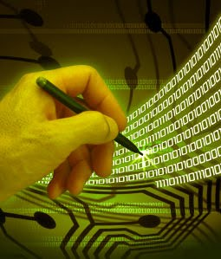
Velocity (Speed)
Data is begin generated fast and need to be processed fast
Online Data Analytics
Late decisions ➔ missing opportunities
Per Second, per hour or data over time
Examples
E-Promotions: Based on your current location, your purchase history, what you like ➔ send promotions right now for store next to you
Healthcare monitoring: sensors monitoring your activities and body ➔ any abnormal measurements require immediate reaction

Slide 12
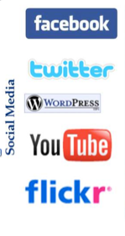
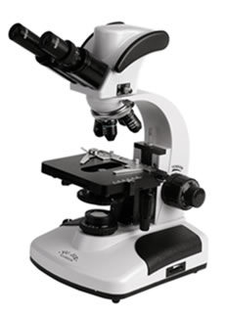

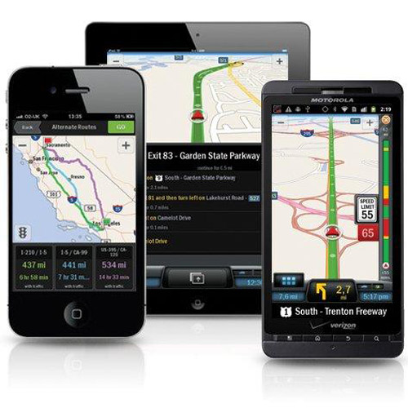
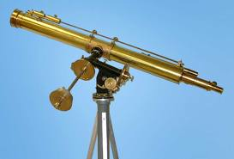
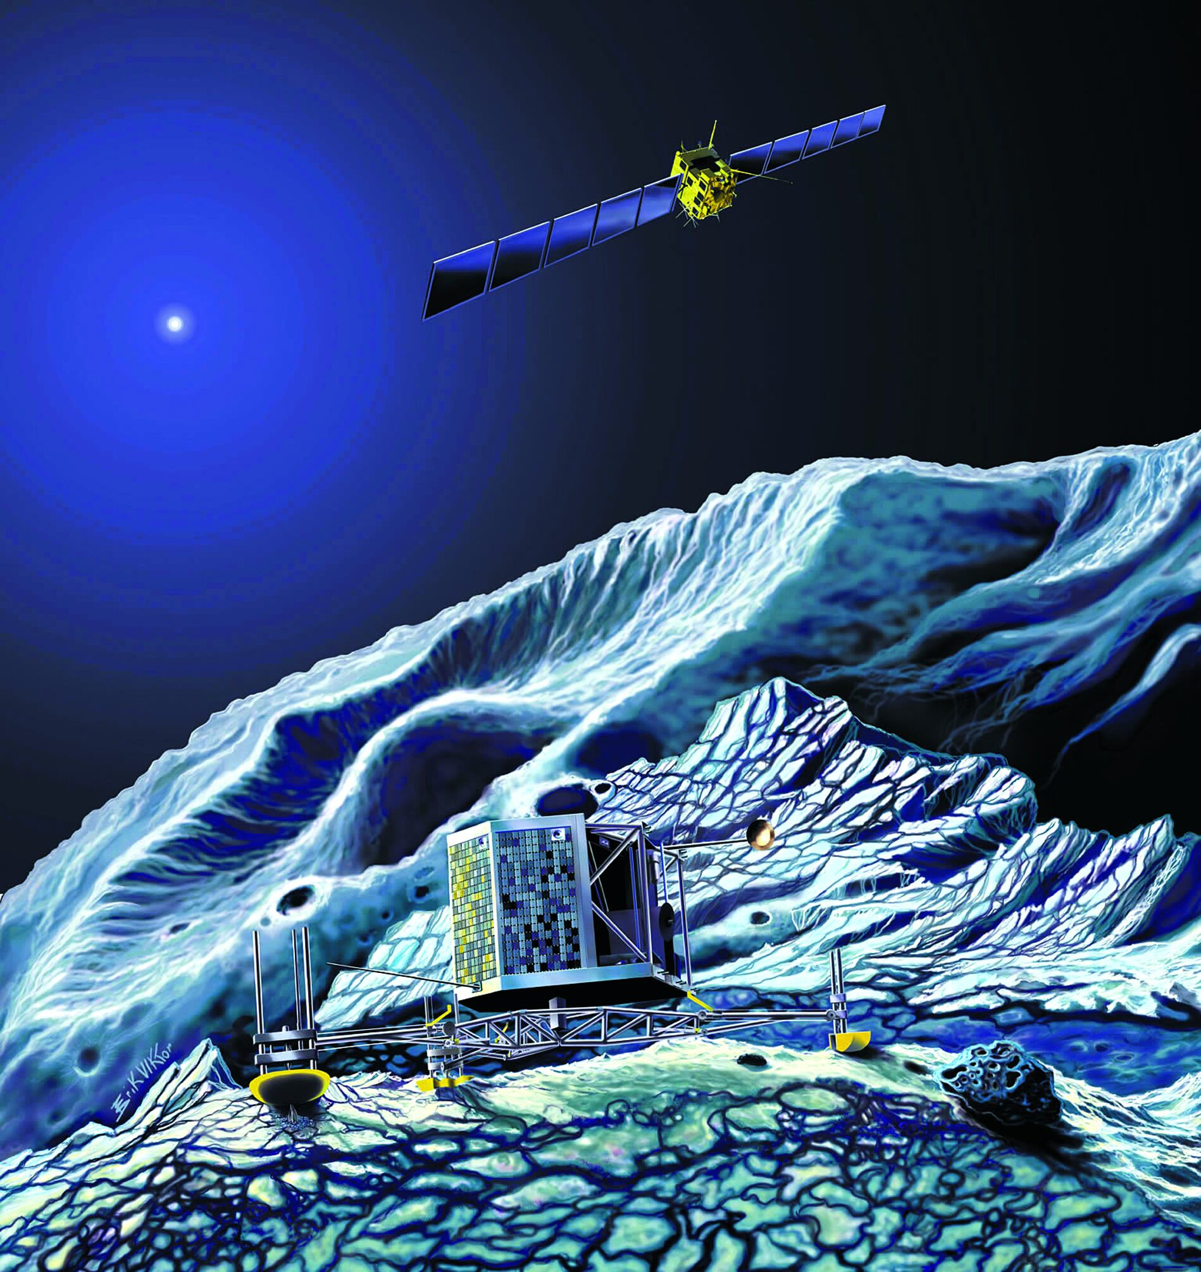
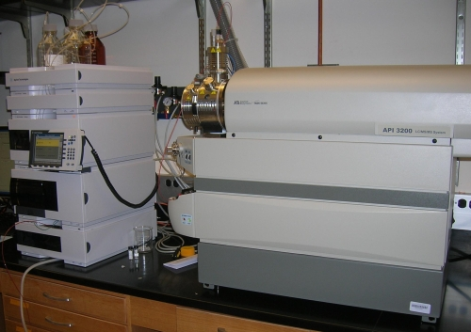
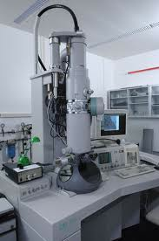
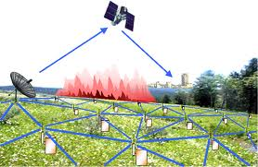
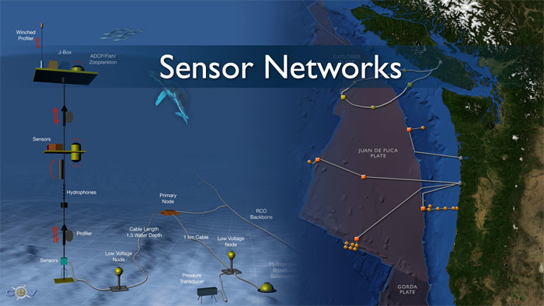
Real-time/Fast Data
Mobile devices
(tracking all objects all the time)
Social media and networks
(all of us are generating data)
Scientific instruments
(collecting all sorts of data)
Sensor technology and networks
(measuring all kinds of data)
The progress and innovation is no longer hindered by the ability to collect data
But, by the ability to manage, analyze, summarize, visualize, and discover knowledge from the collected data in a timely manner and in a scalable fashion

Slide 13
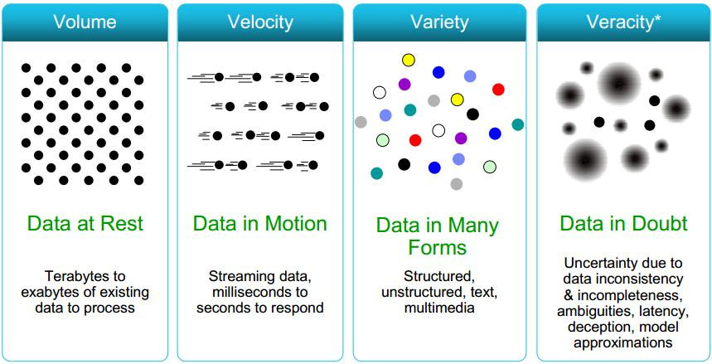
Some Make it 4V’s

Slide 14
The Evolution of Business Intelligence
Interactive Business Intelligence &
In-memory RDBMS
QliqView, Tableau, HANA
Big Data:
Real Time &
Single View
Graph Databases
Speed
Scale
BI Reporting
OLAP &
Dataware house
Business Objects, SAS, Informatica, Cognos other SQL Reporting Tools
Big Data:
Batch Processing &
Distributed Data Store
Hadoop/Spark; HBase/Cassandra
Scale
Speed
1990’s
2000’s
2010’s

Slide 15
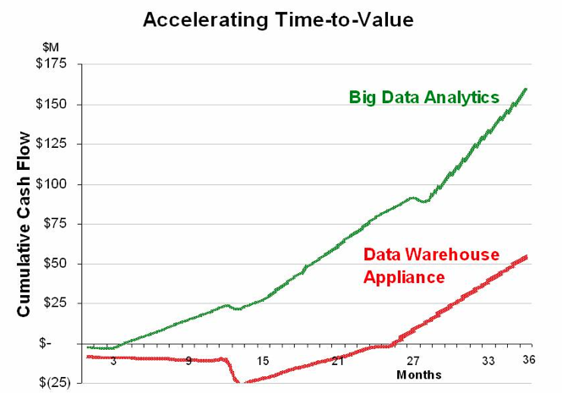
Big Data Analytics
Big data is more real-time in nature than traditional DW applications
Traditional DW architectures (e.g. Exadata, Teradata) are not well-suited for big data apps
Shared nothing, massively parallel processing, scale out architectures are well-suited for big data apps

Slide 16
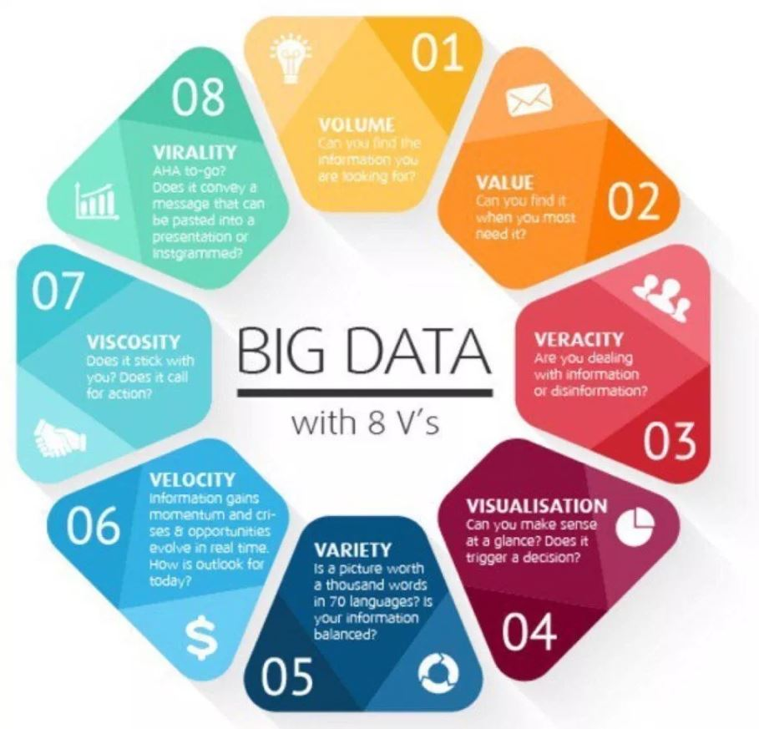
Extend it 8V’s

Slide 17
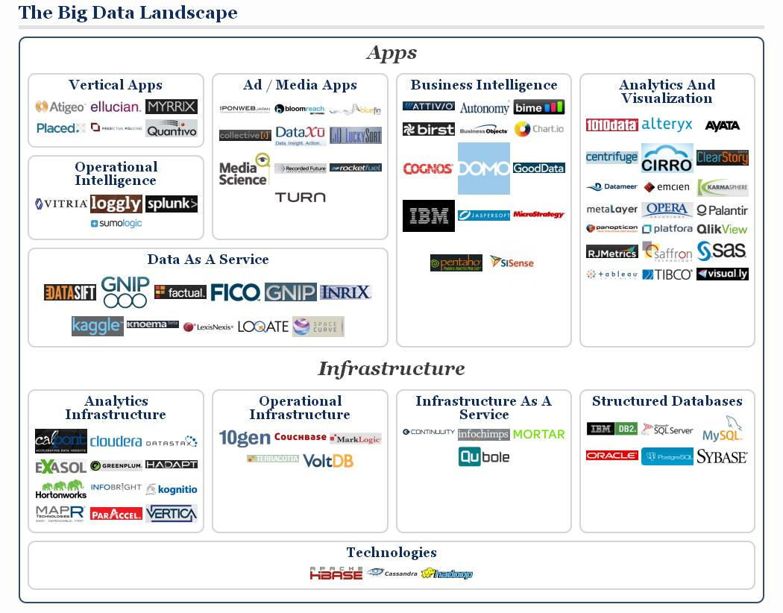

Slide 18
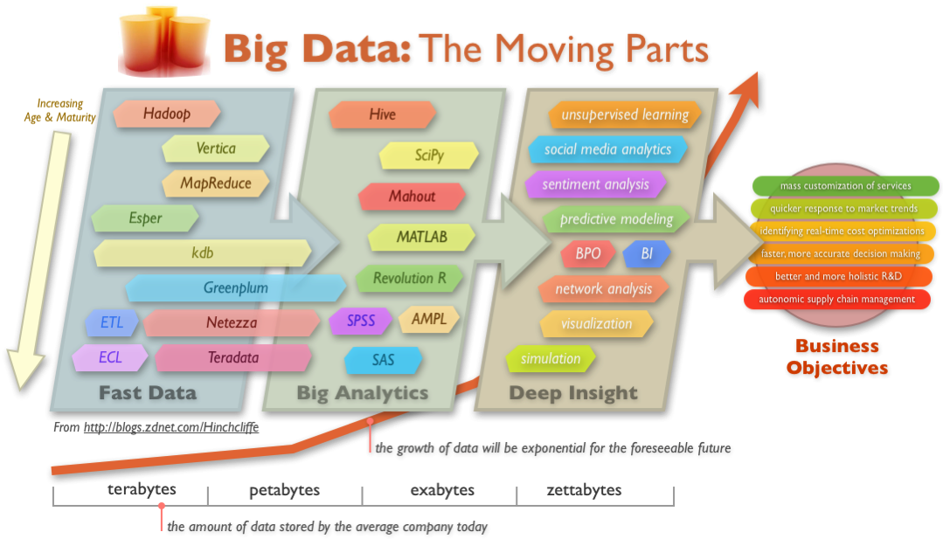

Slide 19
AI -ML

Slide 20
Adding/ integration human Intelligence to machines, cognitive enough to make machines cable to make decisions. Knowledge Representation (KR)/ Rule Based Knowledge database – family – PROLOG/LISP Decision Support Systems (DSS) Natural Language Processing (NLP) Machine Learning (ML) Deep Learning (DL)

Slide 22
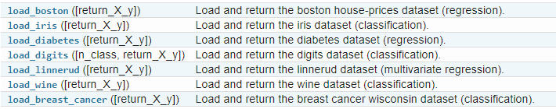
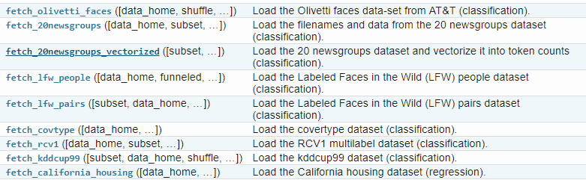
DATASETS – For LEARNING

Slide 23
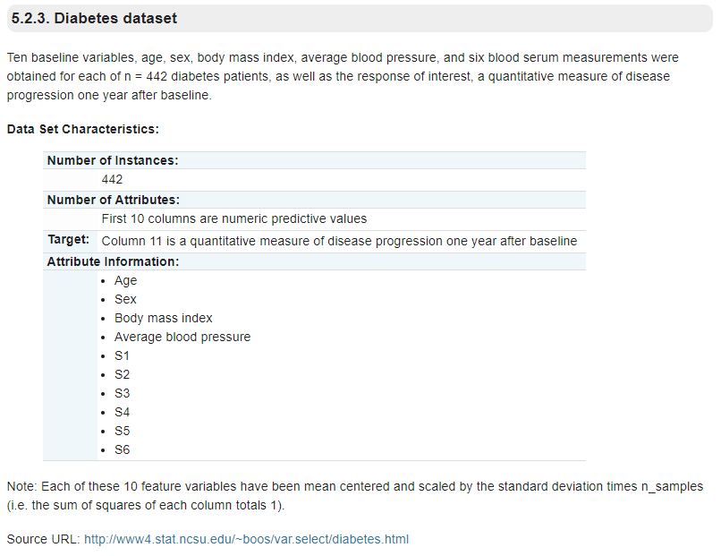
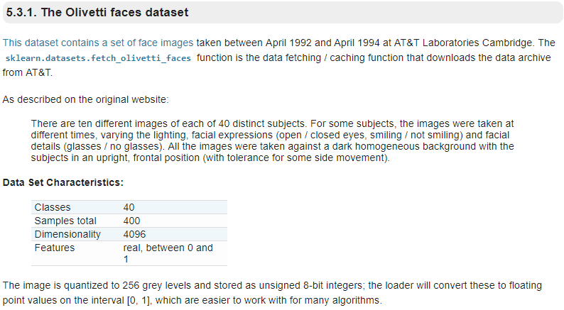
Lecture - 3

Slide 24
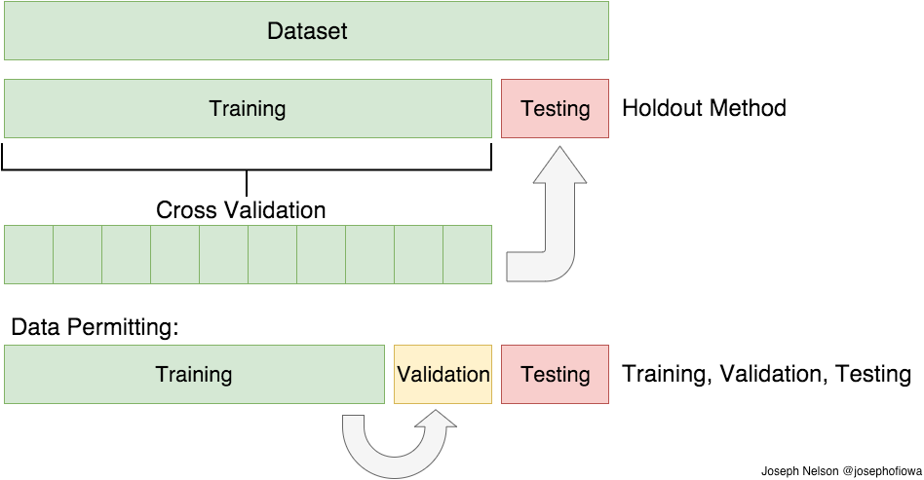
CROSS VALIDATION
(TRAIN/TEST/VAL)

Slide 25
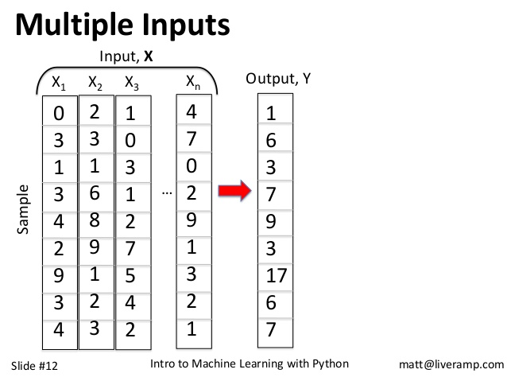
INPUT – X
OUTPUT – Y
COLUMNS
FEATURES SELECTIONS
FEATURES EXTRACTION
FEATURES ENGINEERING
ROWS
# OF SAMPLES
NATURE OF SAMPLES

Slide 26
Learning ? - Task ; Experience ; Evaluate / TEST - Part of life – You can’t stop ? Sleeping/dream Machine Learning ? - learning via machines (computer/tabs/mobile/IoT) - Physics -> Lever/wheel – Ideal 99.99% - Circuits/ ICs - Machine – a Task, Exp, Evaluate - ROBOTS – COMPUTER – MOBILE -

Slide 27
TYPES OF ML: [DATA] 1. Supervised L. - supervisor/Trainer – in-out 2. Unsupervised L. – No super/trainer - in – no out 3. Semi Supervised L. – hybrid 4. Reinforcement L.??? * Natural/env. - GAMES – self learning - ? - Data – Env (limits) + Rules (steps) - Rewards + -

Slide 28
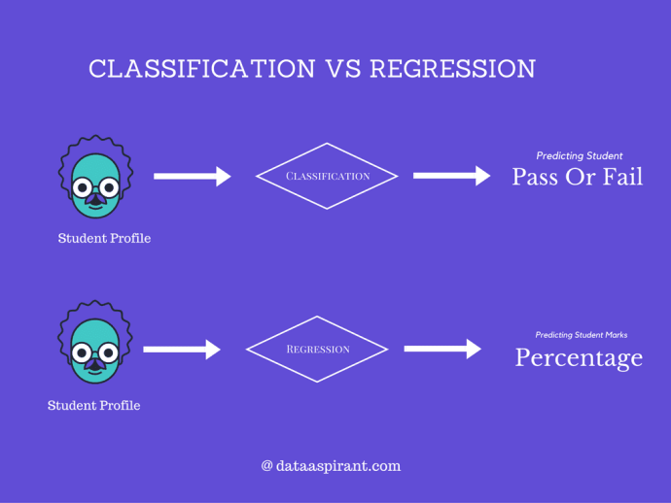
REGRESSION VS CLASSIFICATION
(continuous outcomes for regression, groups discrete for classification)

Slide 29
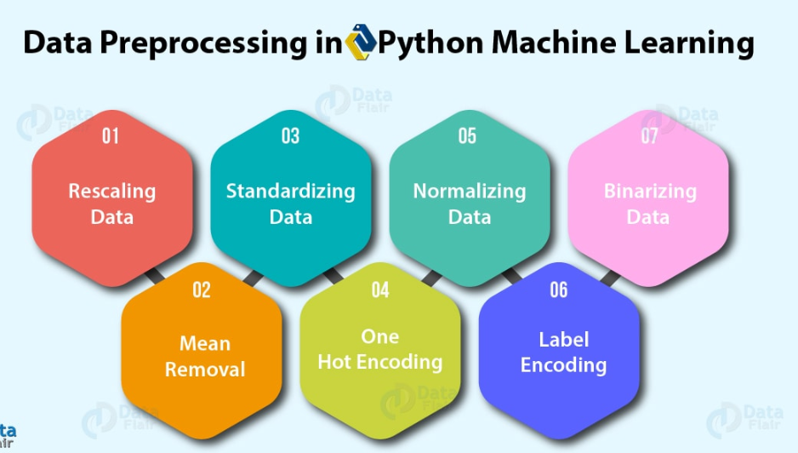
DATA PRE-PROCSESING STEPS
For data with attributes of varying scales
Gaussian distribution and different means and standard deviations
to a length of 1 (a unit norm)
values above it 1 and those equal to or below it, 0
mean from each feature to center it on zero.
dealing with few and scattered numerical values by K-Distinct
Some labels can be words or numbers

Slide 30
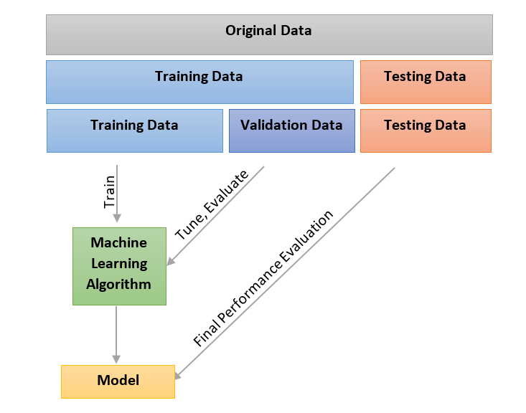
ML – Life Cycle / Flow

Slide 31

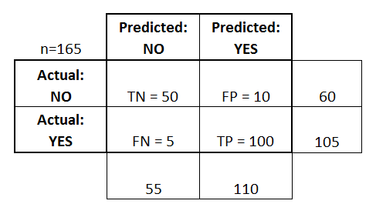
MEASUREMENTS – CONFUSION MATRIX

Slide 32
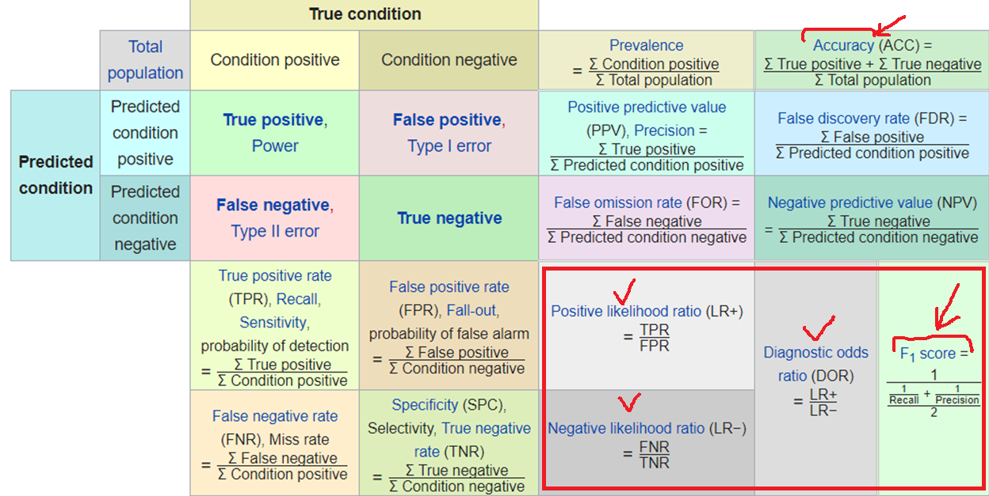
MEASUREMENTS – CONFUSION MATRIX

Slide 33


Slide 34
MACHINE LEARNING MODELS

Slide 35
I - Supervised Learning Linear Regression Decision Tree Naïve Bays kNN

Slide 36
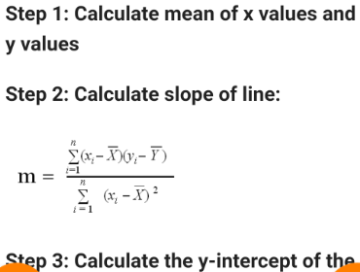
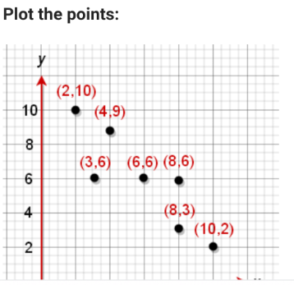
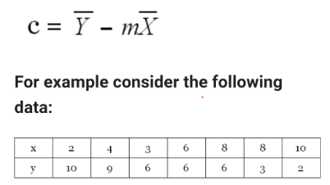
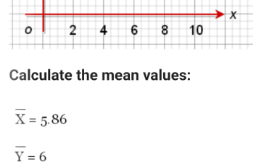
Manual Example – Linear Regression

Slide 37
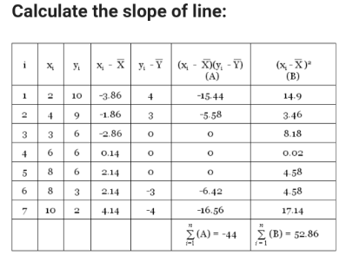
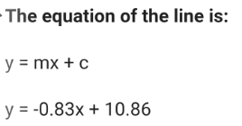
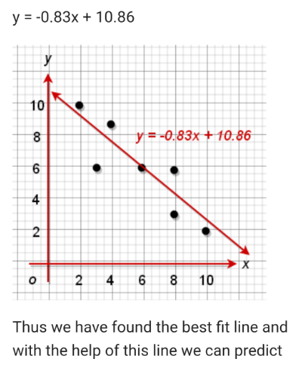
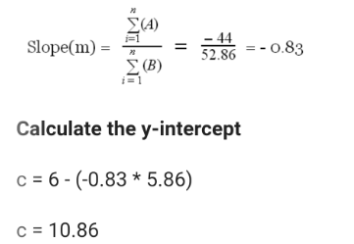
Manual Example – Linear Regression

Slide 38


Slide 39



Slide 40



Slide 41




Slide 42



Slide 43



Slide 44



Slide 45



Slide 46



Slide 47



Slide 48



Slide 49



Slide 50



Slide 51



Slide 52


Slide 53
II - Un-supervised Learning K-Means Cluster SVM PCA CLUSTERS

Slide 54

PCA(Principal Component Analysis)

Slide 55


Slide 56



Slide 57


Slide 58

CLUSTERING

Slide 59
III - Semi – Supervised Learning

Slide 60
Hybrid / mixed form of both Supervised and Unsupervised Learning Models, depending upon the Datasets and Predictions we need. Supervised (Linear Regression) + Unsupervised (PCA)

Slide 61
IV - Reinforcement Learning

Slide 62
Not depends upon the datasets, “Environment & Rewards” (such as machine based games playing, by reward points) Self Learning Models Evolutionary models (FUTURE OF MACHINE LEARNING) – Will be discussed later

Slide 63
APPLCIATIONS / EXAMPLES

